Slide 1

Trie data Structure
Shahar Raz

Slide 2

Introduction
There is a lot of examples of Trie data structure.
the idea of course is the same, but there are a number of variations in the implementation level.
We choose one implementation, the lowest run time, and added it an option to allow effective and simple deletion
The implementation we choose is must efficient in run-time complexity (but wastful in space complexity)

Slide 3
TRIE
Why do we need it?
1. to interduce an ending of a word
2. to alert about typing error (typo) in real time
3. to look for words in low time-complexity (as the length of the searched word)
TRIE can contain many types of values(numbers, objects, letters…) usually it is used for letters. In this presentation we’ll be focusing on lower case English letters.

Slide 4
Generally speaking
Root
F
3
1
_
_
_
t
t
2
F
3
1
Similar to binary tree
We have a root.
The search always starts from the root
The movement in the tree is only downwards
Only node knows only it’s own children.
Unlike binary tree
Each node can contain between 1-26 chars
_
h
_
h
2
F
3
1
i
e
_
_
F
i
1
e
2
T
F
1
s
_
_
_
r
_
F
r
1
T
s
1
T
e
1
e
_
_
_
_
_
_
_
_

Slide 5
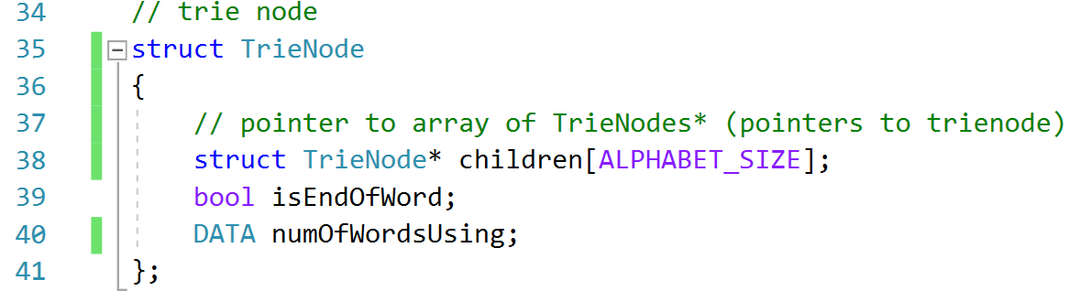
TRIE is a tree that contains Strings in a way so every two words with the same prefix: will use (literally) the same letters. Each node of the Trie would look like this:
\
Inside there is an array named children in alphabet size.
Each letter has compatibly ascii code : for example
So that when we’d like to reach a cell in the array, we’ll subtract ‘a’ from the given letter, and the result will give us the index in children array
for example: to find ‘c’-’s index, we’ll calc: ‘c’-’a’=2 (99-97=2)
Trie Node
a
0
b1
c
2
Each cell is a pointer to other Trie Node
y
24
z
25
IsEndofWord?
NumOfWordsUsing? :
T/F
N
(a = 97) , (z =122)

Slide 6
Actions on Trie
Trie supports the following basic commands:
GetNode()
Insert(Root* , key)
Search(Root* , key)
DelWord(Root*,key)
We will now explain a bit about each action;
First we’ll initialize the TRIE.
O(1)
O(w)
O(L)
O(w)
when
W – the length of the processed word
L – the Length of the longest word in the TRIE

Slide 7
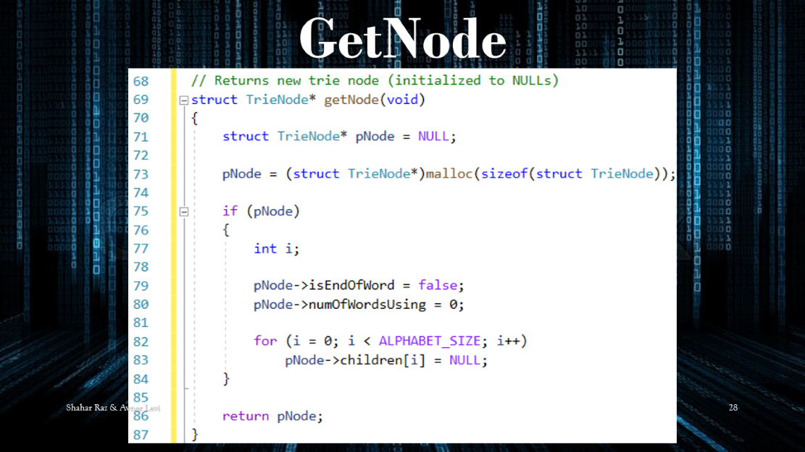

Init TRIE
NULL
In the calling fun we’ll use the next statement:
1. Initialize children array in size 26 so that each cell pointing to NULL
2. Set “is end of word” to false.
3. Set “the number of words using the vertex to 0
In the end, the function well return a pointer
to the Trie’s root.

Slide 8
INSERT)CHAR* STRING(
At first we’ll point to the Trie’s root
1. Check if the first letter in the word exists in the root? As explained before by using ‘curr char’-’a’ to know the index in the array
2. If (the letter doesn’t exist in the node)
Create a new node, and “wire” it as a child in the proper index.
Else, if the letter exists, point the main pointer to the proper node.
Loop through 1&2 till reach the end of the word.

Slide 9
Clarification
Array children contains pointers to nodes only
The letters and the numbers we use are only there for the implementation and the understanding of the array & the problem

Slide 10
Insert word: the
pTN=100
Chr=t
100
ROOT
Address
Title
a0
b1
t-19
y
24
z
25
Create pointer to TrieNode
pTN<-ROOT
Create char
Chr<- t (1st char in word)
a0
b1
c
2
Each cell is a pointer to other Trie Node
y
24
z
25
104
NULL
NULL
F
1
104
t
pTN=104
Chr=h
2. Using Char_To_index
find chr’s index in the array
t(116)-a(97)=19
IsEndofWord?
NumOfWordsUsing? :
T/F
N
a
0
b1
h-7
y
24
z
25
108
F
1
3. If (Arr[19]==NULL)
Create New Node and point Arr[19] to it.
pTN=108
Chr=e
108
h
pTN=108
Chr=\0 / NULL
4.pTN <- Arr[19]
Chr<- h (next char in word)*
repeat steps 2->4
*STOP when chr==null
a
0
b1
e-4
y
24
z
25
112
e
112
a
0
bB1
y
24
z
25
F
1
5. Mark
pTN->isEndOfWord=True
F
T
1

Slide 11
Insert word: to
pTN=100
Chr=t
100
ROOT
Address
Title
a
0
bB1
t-19
y
24
z
25
Create pointer to TrieNode
pTN<-ROOT
Create char
Chr<- t (1st char in word)
a
0
b1
c
2
Each cell is a pointer to other Trie Node
y
24
z
25
104
NULL
NULL
F
2
2. Using Char_To_index
find chr’s index in the array
[for ex: t(116)-a(97)=19 ]
(2.b) pTN->numOf++;
IsEndofWord?
NumOfWordsUsing? :
104
t
pTN=104
Chr=o
T/F
N
a
0
b1
o-14
y
24
z
25
3. If (Arr[19]==NULL)
Create New Node and point Arr[19] to it.
null
116
F
2
4.pTN <- Arr[19]
Chr<- h (next char in word)*
repeat steps 2->4
*STOP when chr==null
116
o
pTN=116
Chr=\0 / NULL
a
0
b1
y
24
z
25
5. Mark
pTN->isEndOfWord=True
T
1

Slide 12
Root
F
1
t h e r e _
0
Lets Insert
there
this
the
to
what
_
_
_
t
F
t
1
0
h
_
_
_
F
h
1
0
e
_
_
_
F
e
1
0
_
_
_
r
F
r
1
0
T
e
1
F
0
e
_
_
_
_
_
_

Slide 13
Root
F
2
t h i s
1
Lets Insert
there
this
the
to
what
_
t
_
F
t
2
1
_
h
_
F
h
2
1
i
e
_
_
F
i
1
e
F
1
s
_
_
_
r
_
F
r
1
T
s
e
F
1
T
1
_
_
e
_
_
_
_
_
_

Slide 14
Root
2
F
3
t h e
1
Let’s Insert:
there
this
the
to
what
_
t
_
t
2
F
3
1
_
h
_
h
2
F
3
1
i
e
_
_
F
i
1
e
2
T
F
1
s
_
_
_
r
_
F
r
1
T
s
1
T
e
1
e
_
_
_
_
_
_
_
_

Slide 15
Root
2
4
F
3
t o
3
Let’s Insert:
there
this
the
to
what
_
t
_
t
4
2
F
3
3
o
h
_
_
T
o
F
1
h
2
F
3
_
_
_
1
i
e
_
_
F
i
1
e
2
T
F
1
s
_
_
_
r
_
F
r
1
T
s
1
T
e
1
e
_
_
_
_
_
_
_
_

Slide 16
Root
2
5
4
F
3
w h a t
1
Let’s Insert:
there
this
the
to
what
_
t
_
w
t
4
w
2
F
3
F
1
1
o
h
_
h
_
_
_
_
T
o
F
1
h
2
F
h
1
F
3
_
_
_
1
_
_
i
e
_
_
a
_
F
i
1
e
2
a
T
F
1
F
1
s
_
_
_
r
_
t
_
_
_
F
r
1
t
T
F
1
T
s
1
T
e
1
e
_
_
_
_
_
_
_
_
_
_
_

Slide 17
SEARCH(CHAR*STRING)
Search gets an array of characters (String)
Start from the first char in the string and point to the root of the Trie
For each char in Sting
a. If its in the node, point pTN to where he points
b. Else – return false (the word is not in our dictionary)
3. If the last char is in the TRIE, and marked as end of a :
the word Found! Return true;
Else : return False

Slide 18
Root
2
5
4
F
3
t h e _
1
Let’s search:
the
thi
that
a
_
t
_
w
t
4
w
2
F
3
F
RETURN TRUE
1
1
o
h
_
h
_
_
_
_
T
o
F
1
h
2
F
h
1
F
3
_
_
_
1
_
_
i
e
_
_
a
_
F
i
1
e
2
a
T
F
1
F
1
s
_
_
_
r
_
t
_
_
_
F
r
1
t
T
F
1
T
s
1
T
e
1
e
_
_
_
_
_
_
_
_
_
_
_

Slide 19
Root
2
5
4
F
3
t h i _
1
Let’s search:
the
thi
that
a
_
t
_
w
t
4
w
2
F
3
F
1
1
o
h
_
h
RETURN FALSE
_
_
_
_
T
o
F
1
h
2
F
h
1
F
3
_
_
_
1
_
_
i
e
_
_
a
_
F
i
1
e
2
a
T
F
1
F
1
s
_
_
_
r
_
t
_
_
_
F
r
1
t
T
F
1
T
s
1
T
e
1
e
_
_
_
_
_
_
_
_
_
_
_

Slide 20
Root
2
5
4
F
3
t h a t _
1
Lets search
the
thi
that
a
_
t
_
w
t
4
w
2
F
3
F
1
1
o
h
_
h
RETURN FALSE
_
_
_
_
T
o
F
1
h
2
F
h
1
F
3
_
_
_
1
_
_
i
e
_
_
a
_
F
i
1
e
2
a
T
F
1
F
1
s
_
_
_
r
_
t
_
_
_
F
r
1
t
T
F
1
T
s
1
T
e
1
e
_
_
_
_
_
_
_
_
_
_
_

Slide 21
Root
2
5
4
F
3
a _
1
Let’s search:
the
thi
that
a
_
t
_
w
t
4
w
2
F
3
F
1
1
o
h
_
h
RETURN FALSE
_
_
_
_
T
o
F
1
h
2
F
h
1
F
3
_
_
_
1
_
_
i
e
_
_
a
_
F
i
1
e
2
a
T
F
1
F
1
s
_
_
_
r
_
t
_
_
_
F
r
1
t
T
F
1
T
s
1
T
e
1
e
_
_
_
_
_
_
_
_
_
_
_

Slide 22
Root
2
5
4
F
3
W h e r e?
1
Can we find
WHERE?
_
t
_
w
t
4
w
2
F
3
F
1
1
o
h
_
h
RETURN FALSE
_
_
_
_
T
o
F
1
h
2
F
h
1
F
3
_
_
_
1
_
_
i
e
_
_
a
_
F
i
1
e
2
a
T
F
1
F
1
s
_
_
_
r
_
t
_
_
_
F
r
1
t
T
F
1
T
s
1
T
e
1
e
_
_
_
_
_
_
_
_
_
_
_

Slide 23
DeleteWord(CHAR* STRING)
Delete a word of the Trie (first make sure that the word is in the Trie, if not return false)
Create a pointer (to node) that point the head of the trie
Create a pointer that runs over the word and now point to first letter
While (next letter is not null
-- count words using node
Find the location of the next letter in children array
If ( your next child is used for only one word)
Free this sun and all it’s children.
Exit while
Place the pointer to next child
Point to next letter
mark node as not end of word, return true;

Slide 24
Root
Let’s Delete:
the
to
there
2
4
5
4
F
3
t h e _
1
_
t
_
w
t
4
w
3
2
F
3
F
1
1
o
h
_
h
_
_
_
_
T
o
F
1
h
2
F
h
2
1
F
3
_
_
_
1
_
_
i
e
_
_
a
_
F
i
1
e
2
a
F
1
T
F
1
F
1
s
_
_
_
r
_
t
_
_
_
F
r
1
t
T
F
1
T
s
1
T
e
1
e
_
_
_
_
_
_
_
_
_
_
_

Slide 25
Root
Lets Delete
the
to
there
2
3
4
5
4
F
3
t o _
1
_
t
_
w
t
4
w
3
2
3
F
2
F
1
1
o
h
_
h
_
_
_
_
_
FREE RECURSIVLY
T
o
1
F
1
h
2
F
h
2
1
F
3
_
_
_
1
_
_
i
e
_
_
a
_
F
i
1
e
2
a
F
1
T
F
1
F
1
s
_
_
_
r
_
t
_
_
_
F
r
1
t
T
F
1
T
s
1
T
e
1
e
_
_
_
_
_
_
_
_
_
_
_

Slide 26
Root
Let’s Delete:
the
to
there
2
2
3
5
4
F
3
t h e r e
1
_
t
_
w
t
4
w
2
2
3
F
1
F
1
1
_
h
_
h
_
_
_
_
h
2
F
h
2
1
F
3
1
1
_
_
_
_
a
i
e
_
_
F
i
1
e
2
a
F
1
T
0
F
1
F
1
FREE RECURSIVLY
s
_
_
_
r
_
t
_
_
_
F
r
1
t
T
F
1
T
s
1
T
e
1
e
_
_
_
_
_
_
_
_
_
_
_

Slide 27
Functions:

Slide 28
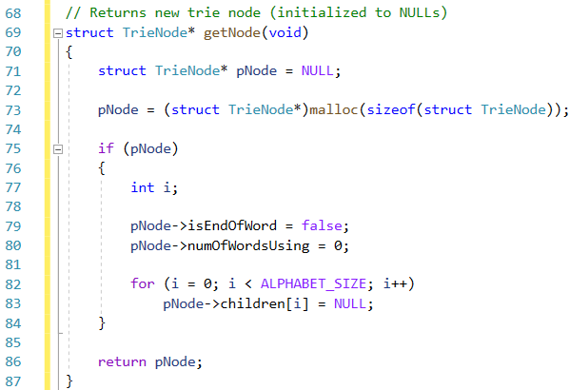
GetNode

Slide 29
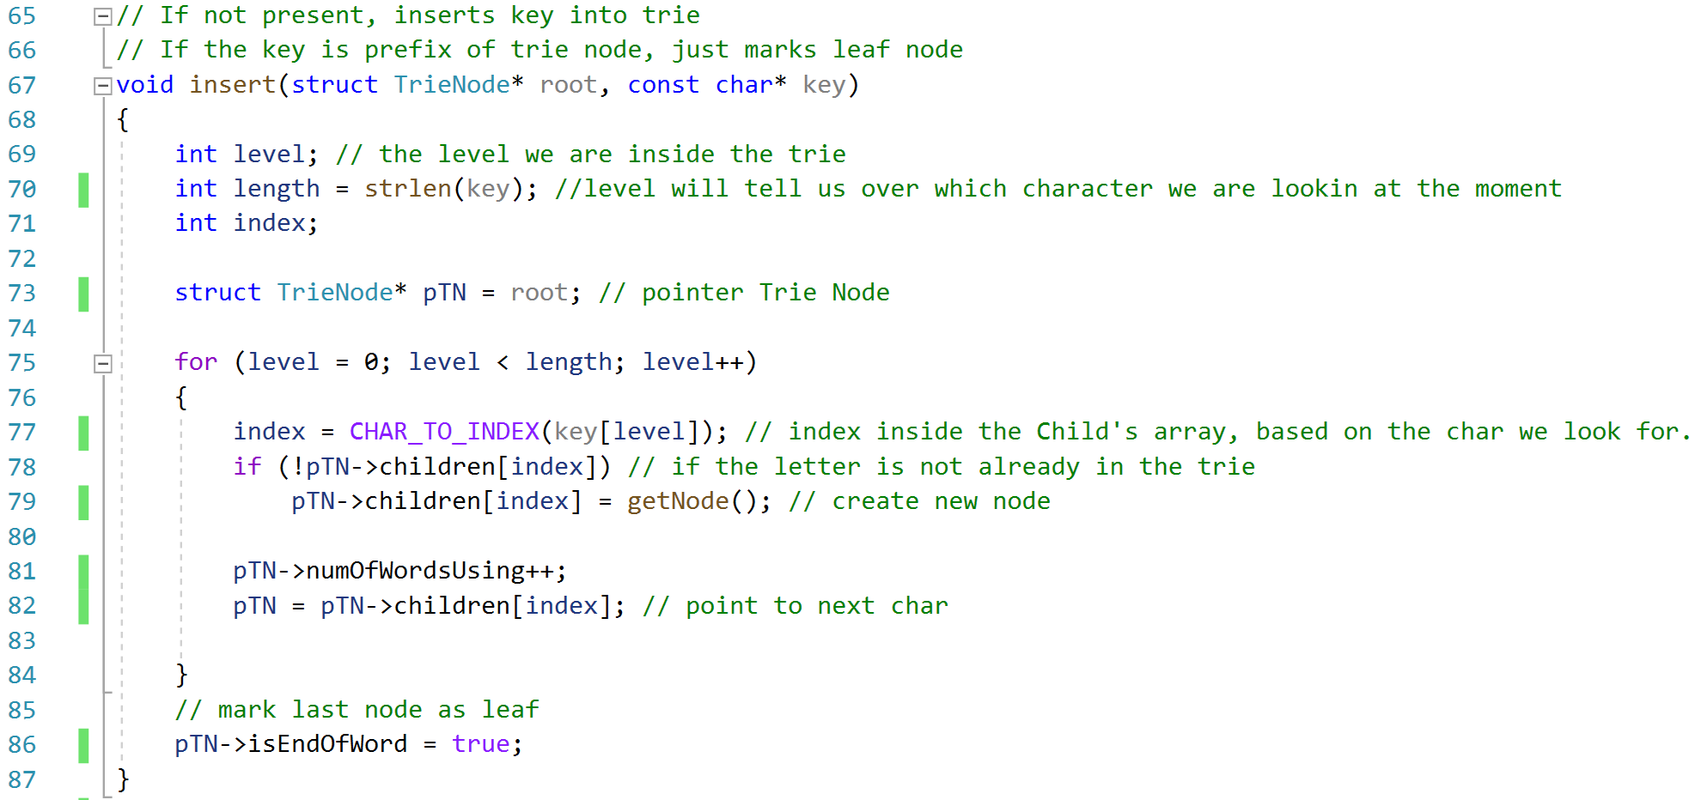
Insert

Slide 30
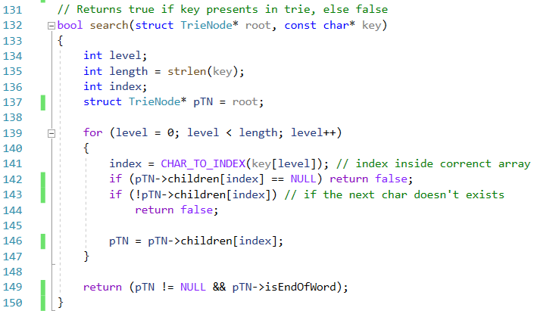
Search

Slide 31
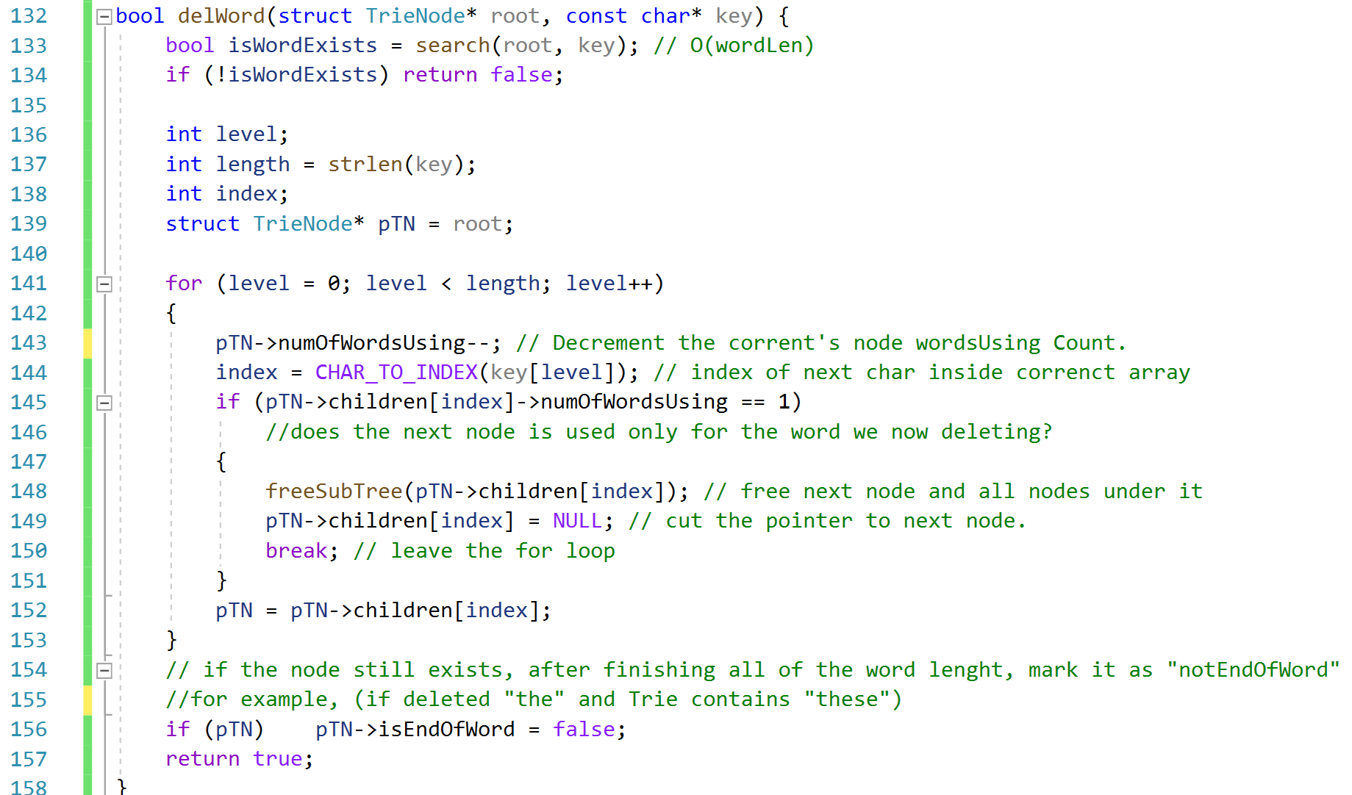
Delete Word

Slide 32
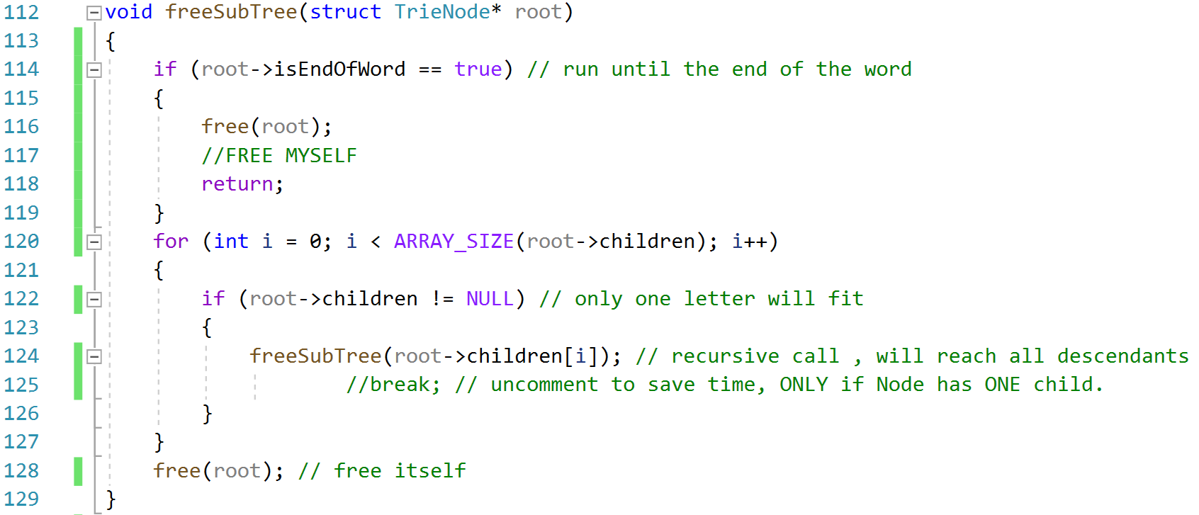
Free Sub Trie
פונקציה רקורסיבית
תנאי עצירה

Slide 33
The End
Shahar Raz

